Slide 1



Splash Screen

Slide 2
Lesson Menu
Then/Now
New Vocabulary
Example 1: Two Real Solutions
Key Concept: Solutions of a Quadratic Equation
Example 2: One Real Solution
Example 3: No Real Solution
Example 4: Estimate Roots
Example 5: Solve by Using a Table
Example 6: Real-World Example: Solve by Using a Calculator

Slide 3


Then/Now
You solved systems of equations by graphing. (Lesson 3–1)
Solve quadratic equations by graphing.
Estimate solutions of quadratic equations by graphing.

Slide 4


Vocabulary
quadratic equation
standard form
root
zero

Slide 5

Example 1
Two Real Solutions
Solve x² + 6x + 8 = 0 by graphing.
Graph the related quadratic function f(x) = x² + 3x + 8.
The equation of the axis of symmetry is x = –3.
Make a table using x-values around –3.
Then graph each point.

Slide 6
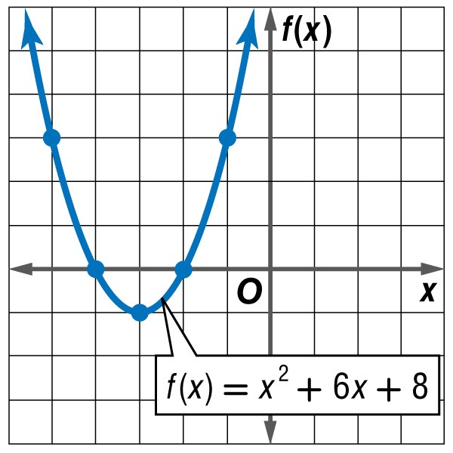
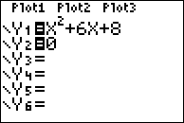
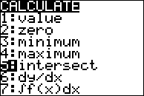
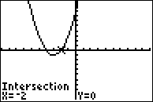
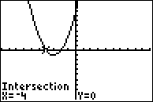
Check
Two Real Solutions
We can see that the zeros of the function are –4 and –2.
Answer: The solutions of the equation are –4 and –2.
CHECK (on calculator):
Enter equation in Y1
Enter Y2=0
Find intersection(s) of the lines.
Check by hand: x ² + 6x + 8 = 0 x ² + 6x + 8 = 0
?
?
        (–4)² + 6(–4) + 8 = 0 (–2)² + 6(–2) + 8 = 0
✓
✓
0 = 0 0 = 0

Slide 7


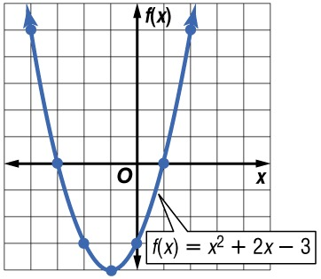
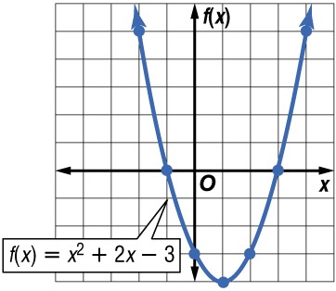
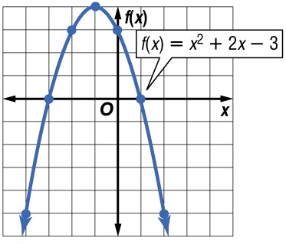
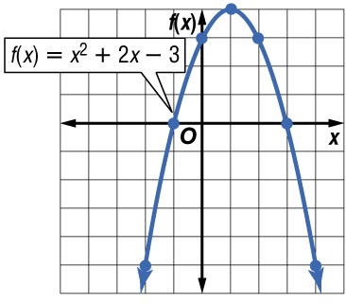
Example 1
Solve x² + 2x – 3 = 0 by graphing.
A. B.
C. D.
–3, 1
–1, 3
A
B
C
D
–3, 1
–1, 3

Slide 8
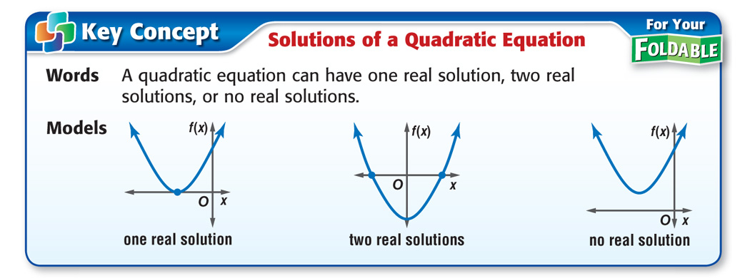
Concept

Slide 9
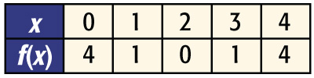
Example 2
One Real Solution
Solve x² – 4x = –4 by graphing.
Write the equation in ax² + bx + c = 0 form.
x² – 4x = –4 x² – 4x + 4 = 0 Add 4 to each side.
Graph the related quadratic function f(x) = x² – 4x + 4.

Slide 10
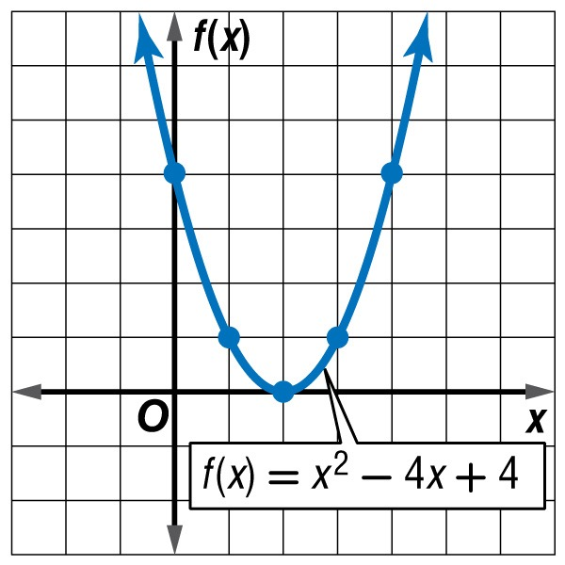
Example 2
One Real Solution
Notice that the graph has only one x-intercept, 2.
Answer: The only solution is 2.

Slide 11
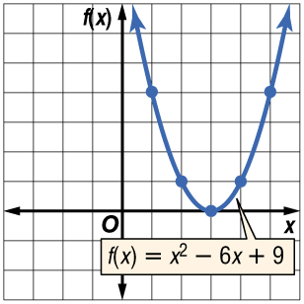
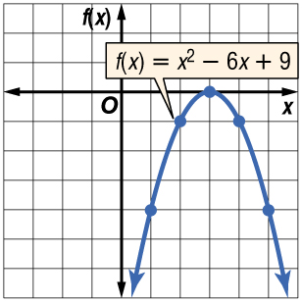
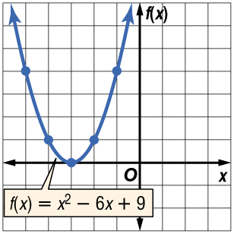
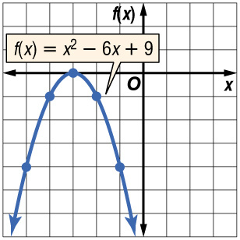
Example 2
Solve x² – 6x = –9 by graphing.
A. B.
C. D.
3
3
A
B
C
D
–3
–3

Slide 12
Example 3
No Real Solution
NUMBER THEORY Use a quadratic equation to find two numbers with a sum of 4 and a product of 5.
Understand Let x = one of the numbers. Then
4 – x = the other number.
Plan
x(4 – x) = 5 The product is 5.
4x – x² = 5 Distributive Property
x² – 4x + 5 = 0 Add x² and subtract 4x from each side.
Solve Graph the related function.

Slide 13
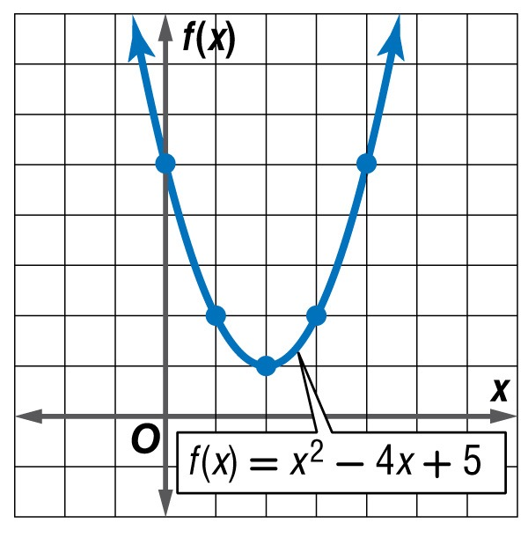
Example 3
No Real Solution
The graph has no x-intercepts. This means that the original equation has no real solution.
Answer: It is not possible for two real numbers to have a sum of 4 and
a product of 5.
Check Try finding the product of several numbers whose sum is 4.

Slide 14
Example 3
NUMBER THEORY Use a quadratic equation to find two numbers with a sum of 7 and a product of 14.
A. 7, 2
B. –7, –2
C. 5, 2
D. no such numbers exist
A
B
C
D

Slide 15

Example 4
Estimate Roots
Solve –x² + 4x – 1 = 0 by graphing. If exact roots cannot be found, state the consecutive integers between which the roots are located.
Make a table of values and graph the related function.

Slide 16
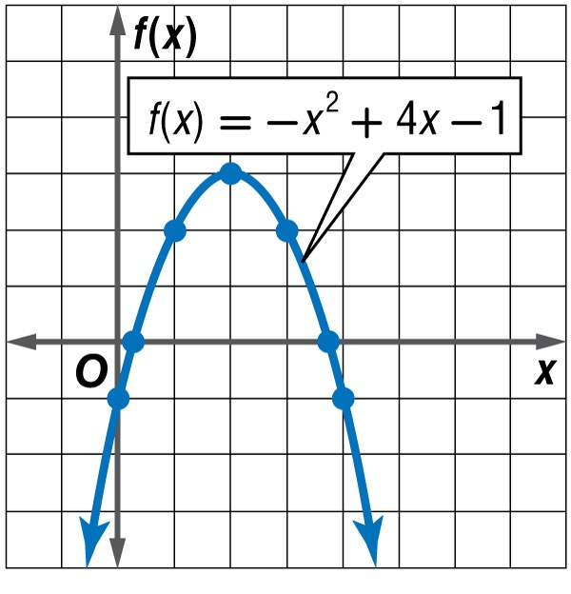
Example 4
Estimate Roots
The x-intercepts of the graph are between 0 and 1 and between 3 and 4.
Answer: One solution is between 0 and 1 and the other is between 3 and 4.

Slide 17
Example 4
Solve x² – 4x + 2 = 0 by graphing. What are the consecutive integers between which the roots are located?
A. 0 and 1, 3 and 4
B. 0 and 1
C. 3 and 4
D. –1 and 0, 2 and 3
A
B
C
D

Slide 18
Example 5
Solve by Using a Table
Solve x² + 5x – 7 = 0.
Enter y₁ = x ² + 5x – 7 in your graph calculator. Use the TABLE window to find where the sign of Y1 changes. Change ΔTbl to 0.1 and look again for the sign change. Replace the process with 0.01 and 0.001 to get a more accurate location of the zero.

Slide 19
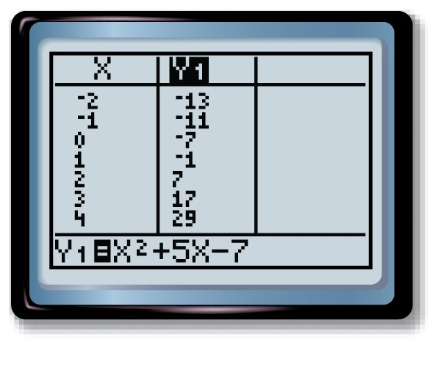
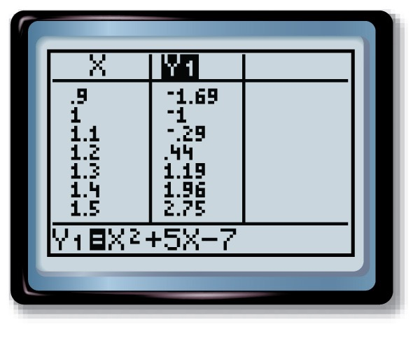
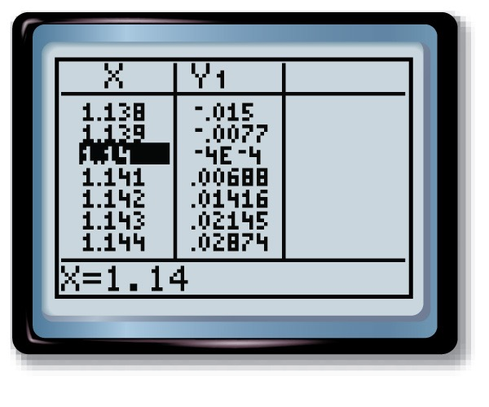
Example 5
Solve by Using a Table
Answer: One solution is approximately 1.140.

Slide 20
Example 5
Locate the second zero in the function
x² + 5x – 7 = 0 from Example 5.
A. –1.140
B. –3.140
C. –5.140
D. –6.140
A
B
C
D

Slide 21
Example 6
Solve by Using a Calculator
ROYAL GORGE BRIDGE The highest bridge in the United States is the Royal Gorge Bridge in Colorado. The deck of the bridge is 1053 feet above the river below. Suppose a marble is dropped over the railing from a height of 3 feet above the bridge deck. How long will it take the marble to reach the surface of the water, assuming there is no air resistance? Use the formula
h(t) = –16t ² + h₀, where t is the time in seconds and h₀ is the initial height above the water in feet.
We need to find t when h₀ = 1056 and h(t) = 0.

Slide 22
Example 6
Solve by Using a Calculator
Solve 0 = –16t ² + 1056.
Graph the related function y = –16t ² + 1056 using a graphing calculator. Adjust your window so that the
x-intercepts are visible.
Use the zero feature, [CALC], to find the positive
zero of the function, since time cannot be negative.
Use the arrow keys to locate a left bound for the zero
and press .
2nd
ENTER
ENTER
Then locate a right bound and press twice.

Slide 23
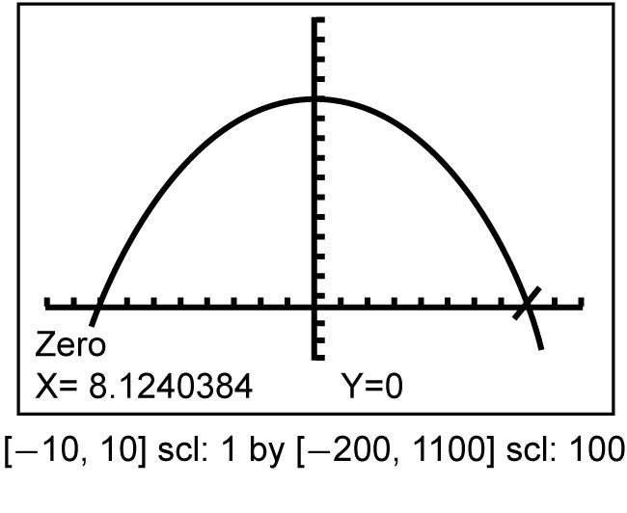
Example 6
Solve by Using a Calculator
Answer: The positive zero of the function is approximately 8. It should take about
8 seconds for the marble to reach the surface of the water.

Slide 24
Example 6
HOOVER DAM One of the largest dams in the United States is the Hoover Dam on the Colorado River, which was built during the Great Depression. The dam is 726.4 feet tall. Suppose a marble is dropped over the railing from a height of 6 feet above the top of the dam. How long will it take the marble to reach the surface of the water, assuming there is no air resistance? Use the formula h(t) = –16t ² + h₀, where
t is the time in seconds and h₀ is the initial height above the water in feet.
A
B
C
D
A. about 6 seconds
B. about 7 seconds
C. about 8 seconds
D. about 10 seconds

Slide 25
End of the Lesson

